Slide 1
Induction
Rajasekaran S
Assistant Professor,
Department of Information Technology,
KGiSL Institute of Technology,
email: proffraja@gmail.com
Github:www.github.com/rajasekaranap

Slide 2
Things for Thought Process
I have programmed with python and C.
Is there any languages like this. https://en.wikipedia.org/wiki/List_of_programming_languages
Am I need to study all the languages that is created.
Then why I need to study java?
Is that much important ?

Slide 3
Discusstion
Python vs C
What is Good & What is Bad

Slide 4
How developer chooses a Language
There are many factors
Programmers perspective
What is the requirement.
Is it an update or need to do from scratch.
What is time required or deadline.
Software companies perspective
What is the requirement?
What is the technology?
How much time & resource needed?
How much I can get it?

Slide 5
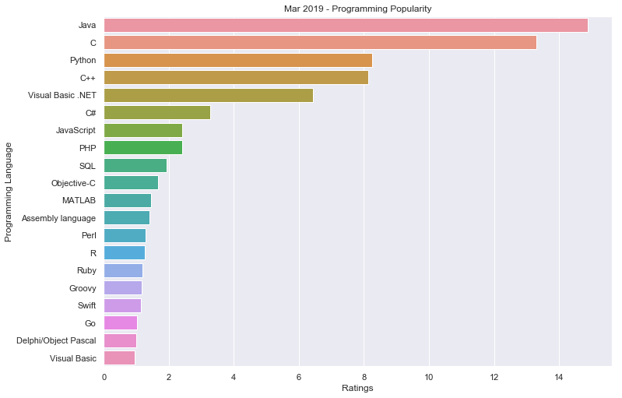
Why Java

Slide 6
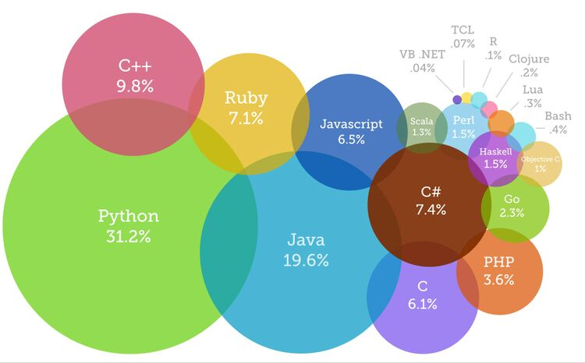
Contribution of Languages

Slide 7
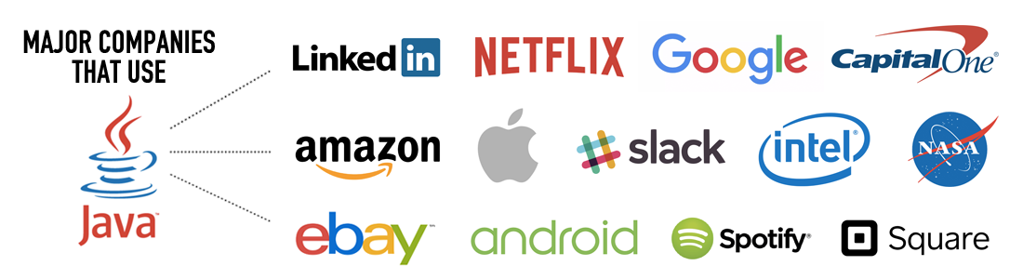
Companies using Java
https://www.quora.com/Where-is-Java-used

Slide 8
Thank You
Rajasekaran S
Assistant Professor,
Department of Information Technology,
KGiSL Institute of Technology,
email: proffraja@gmail.com
Github:www.github.com/rajasekaranap

